Slide 1




Slide 2

MongoDB

Slide 3
MongoDB
Mongoose
CRUD operations
Authentication

Slide 4


MongoDB
Famous noSQL database
Each database contains collections
Each collection contains documents
Documents are JSON objects
Each document can have different structure (schema)
Unlike SQL databases, it uses predefined functions instead of a query language

Slide 5
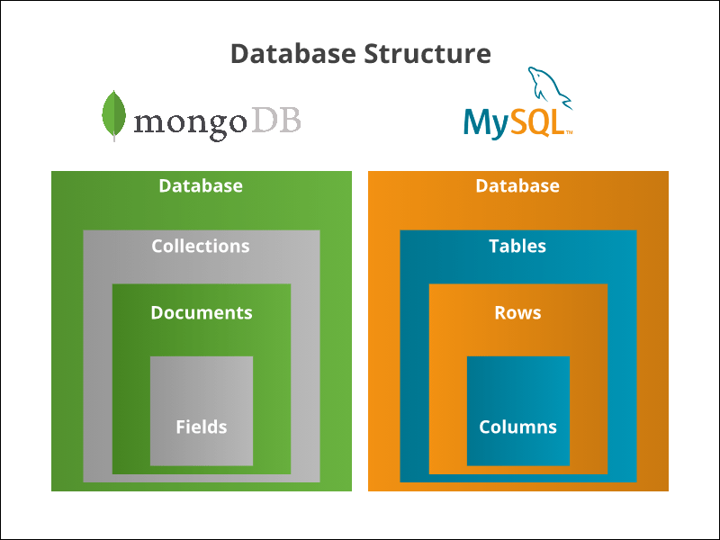
MongoDB

Slide 6
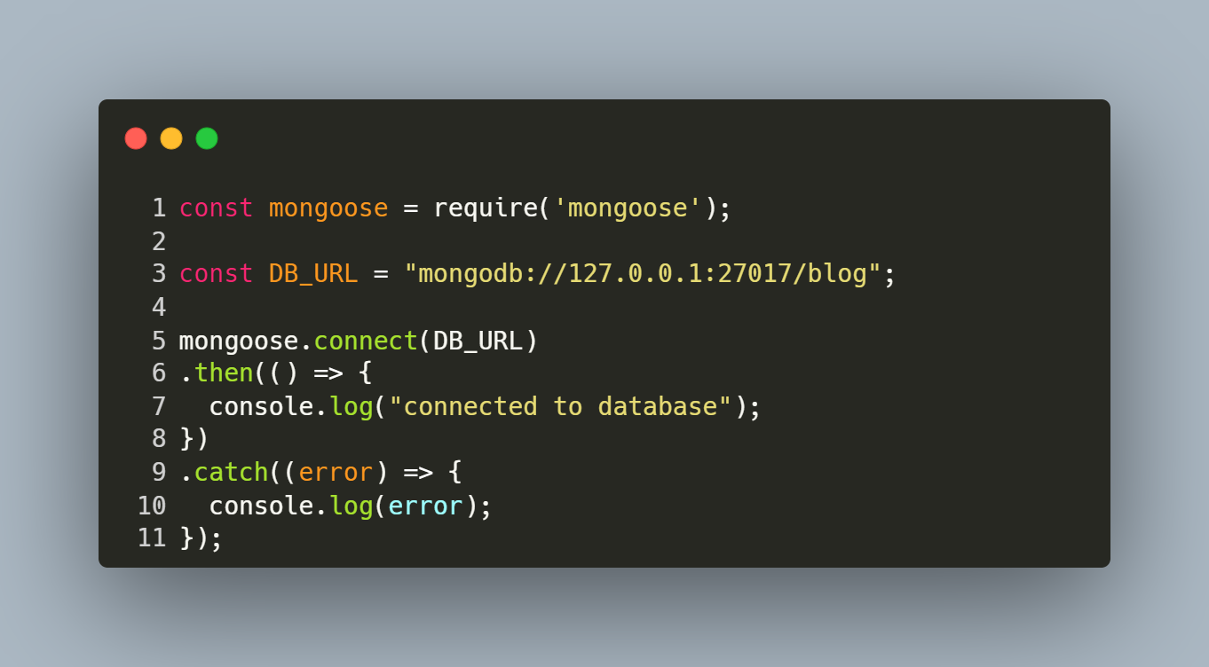
Mongoose (Object Document Mapping package)

Slide 7
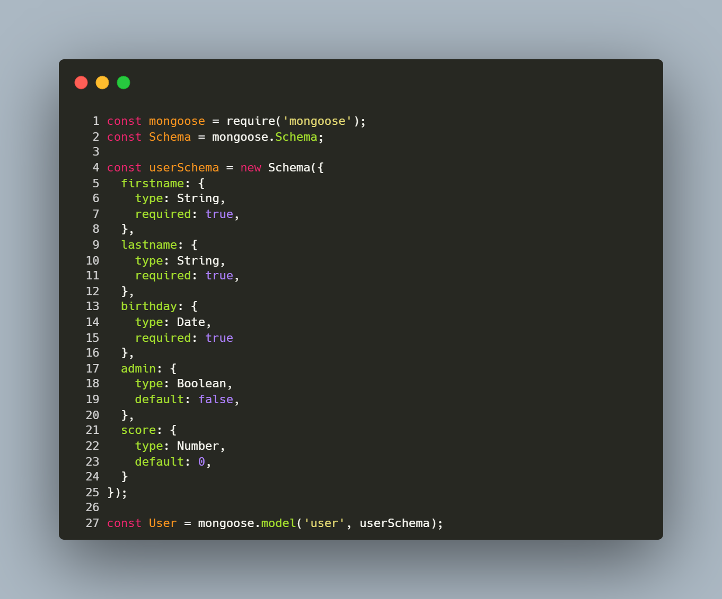
Model

Slide 8
Common functions
find()
findOne()
findById()
findOneAndUpdate() , findByIdAndUpdate()
findOneAndDelete(), findByIdAndDelete()
updateOne()
updateMany()
deleteOne()
deleteMany()

Slide 9
Create a document

Slide 10
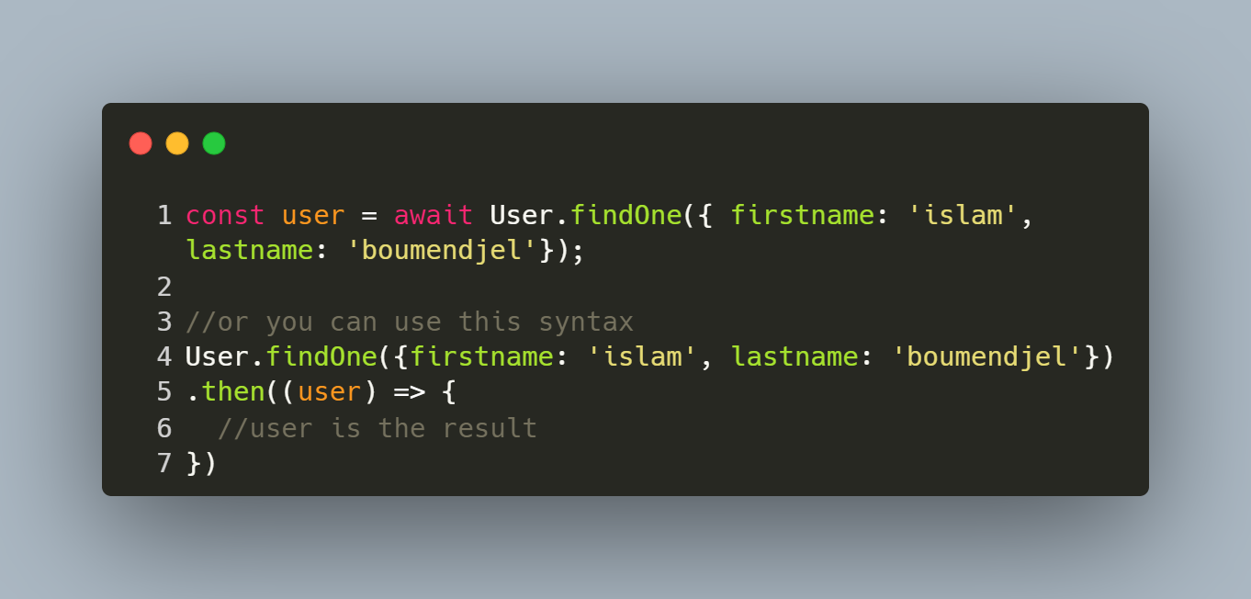
Get a document

Slide 11
Get many documents

Slide 12
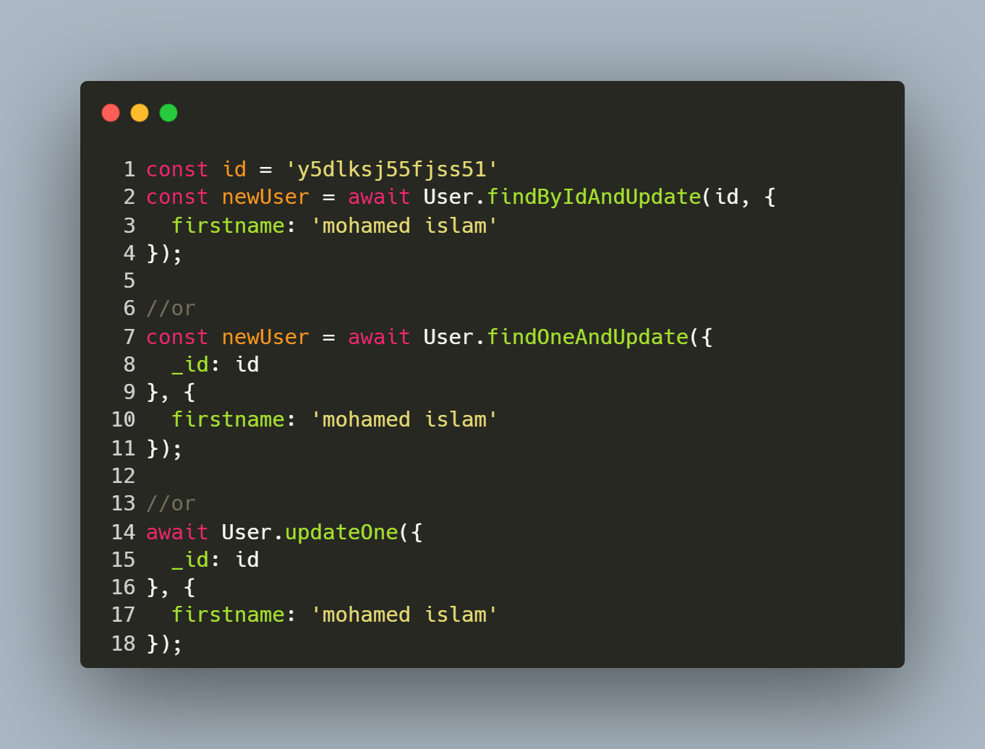
Update a document

Slide 13
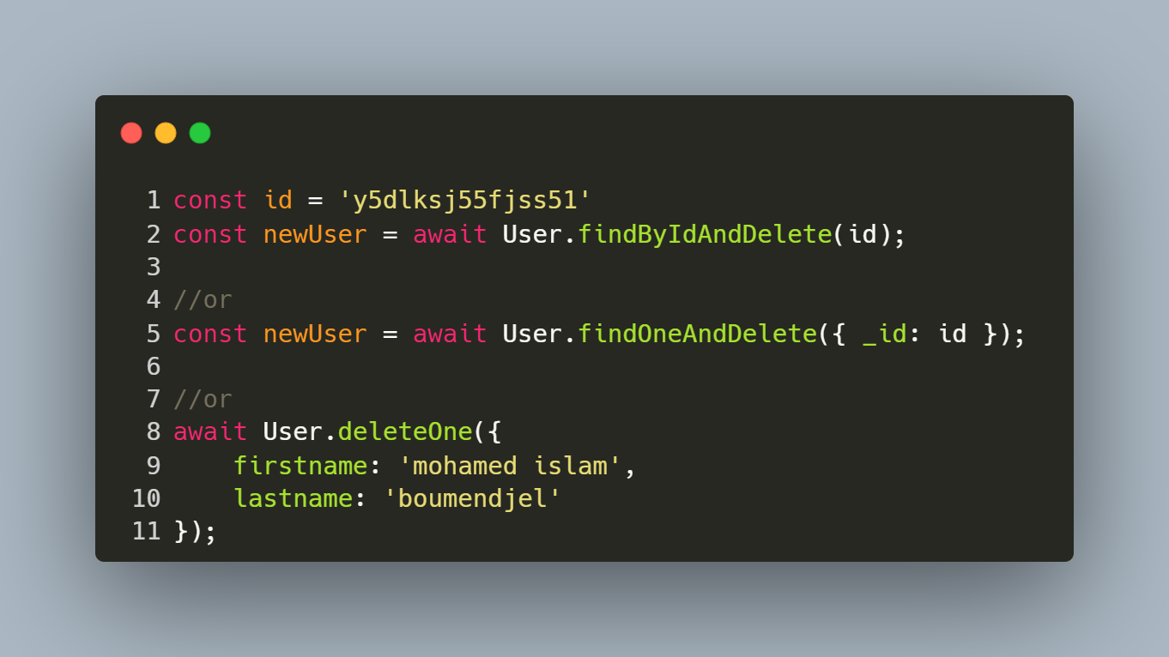
Delete a document

Slide 14
Authentication

Slide 15

JWT tokens
- There are many methods for authentication
- JWT stands for ‘‘JSON Web Token’’
- When the client logs in, the server returns to him a token.
- When the client makes a request, he must attach the token in the request’s header. - The server verifies the token, if it’s valid, it returns the requested data. Otherwise, the request won’t be satisfied

Slide 16
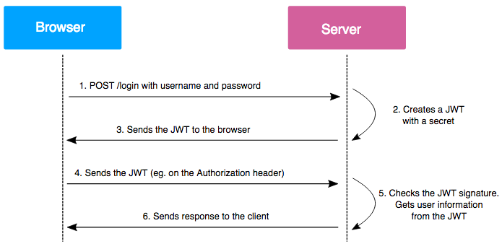
JWT tokens

Slide 17
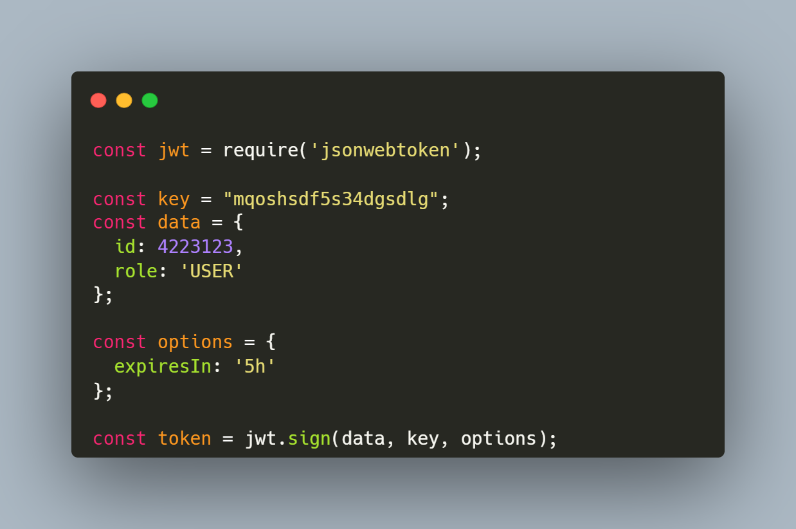
Generate a token

Slide 18
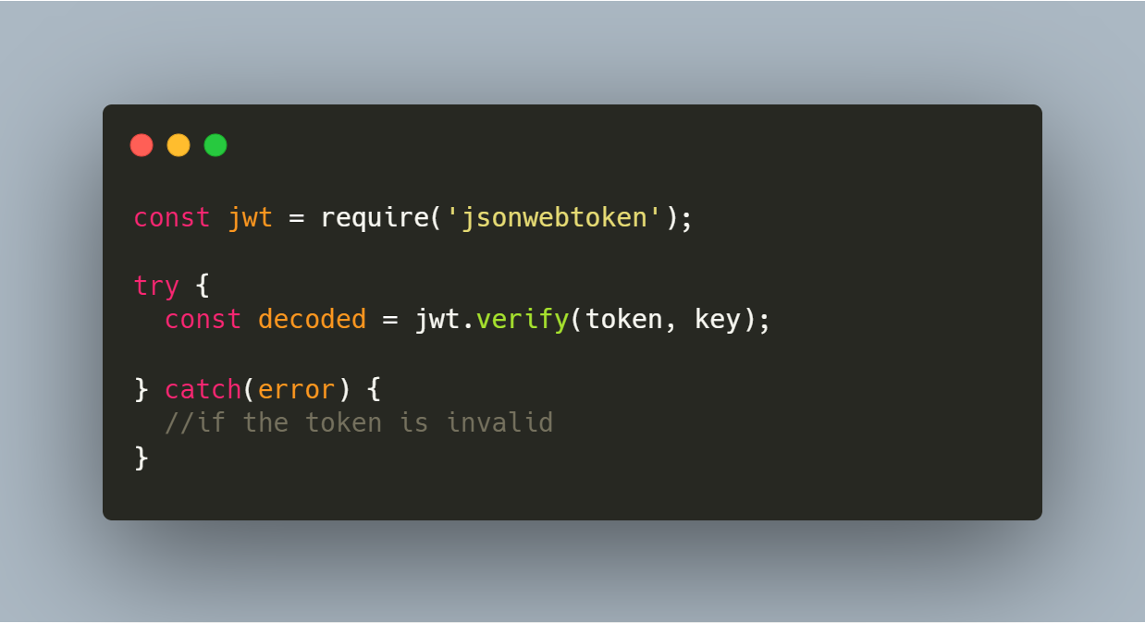
Verify a token

Slide 19
resources
https://docs.mongodb.com/manual/crud/
https://mongoosejs.com/
https://www.youtube.com/watch?v=-0exw-9YJBo
https://www.npmjs.com/package/jsonwebtoken
https://www.npmjs.com/package/bcrypt
https://www.youtube.com/watch?v=enopDSs3DRw

Slide 20

Thank you for your kind attention!

